Slide 1
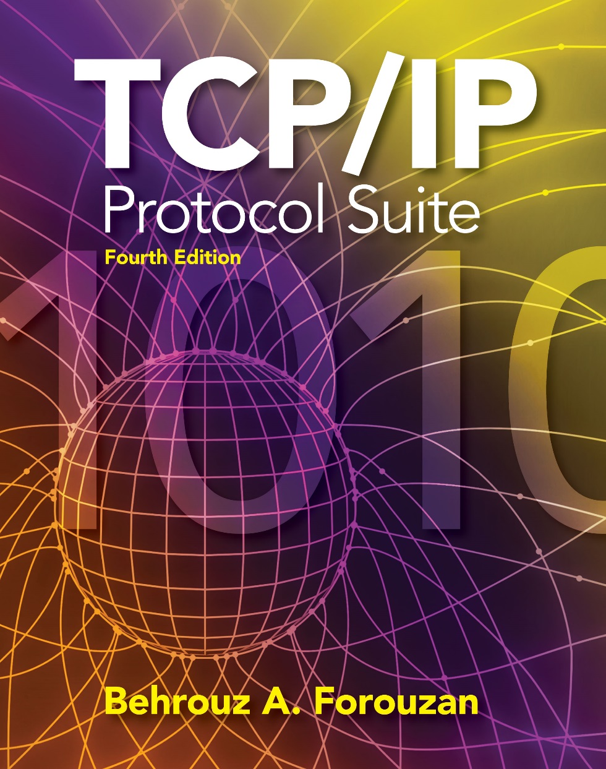
Chapter 15
Transmission
Control
Protocol
(TCP)
Copyright © The McGraw-Hill Companies, Inc. Permission required for reproduction or display.

Slide 2
OBJECTIVES:
To introduce TCP as a protocol that provides reliable stream delivery service.
To define TCP features and compare them with UDP features.
To define the format of a TCP segment and its fields.
To show how TCP provides a connection-oriented service, and show the segments exchanged during connection establishment and connection termination phases.
To discuss the state transition diagram for TCP and discuss some scenarios.
To introduce windows in TCP that are used for flow and error control.

Slide 3
OBJECTIVES (continued):
To discuss how TCP implements flow control in which the receive window controls the size of the send window.
To discuss error control and FSMs used by TCP during the data transmission phase.
To discuss how TCP controls the congestion in the network using different strategies.
To list and explain the purpose of each timer in TCP.
To discuss options in TCP and show how TCP can provide selective acknowledgment using the SACK option.
To give a layout and a simplified pseudocode for the TCP package.

Slide 4
Chapter
Outline
15.1 TCP Services
15.2 TCP Features
15.3 Segment
15.4 A TCP Connection
15.5 State Transition Diagram
15.6 Windows in TCP
15.7 Flow Control
15.8 Error Control
15.9 Congestion Control
15.10 TCP Timers
15.11 Options
15.12 TCP Package

Slide 5
15-3 SEGMENT
Before discussing TCP in more detail, let us discuss the TCP packets themselves. A packet in TCP is called a segment.

Slide 6
Topics Discussed in the Section
Format
Encapsulation

Slide 7
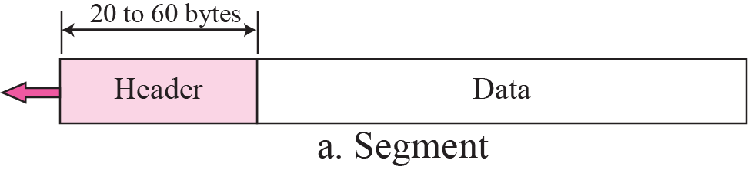
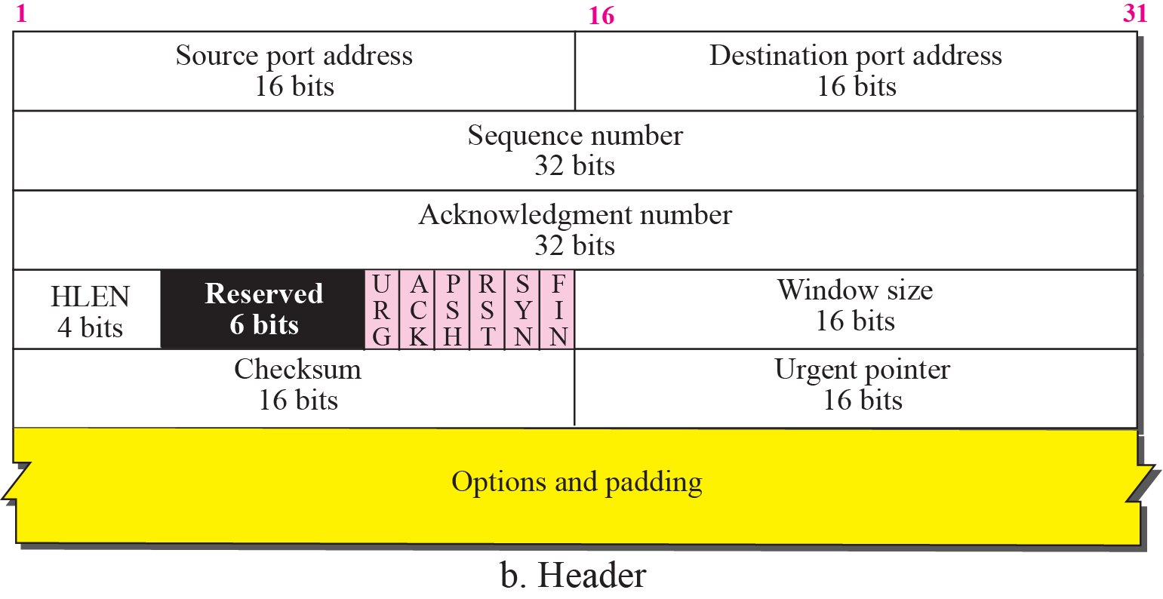

Figure 15.5 TCP segment format

Slide 8
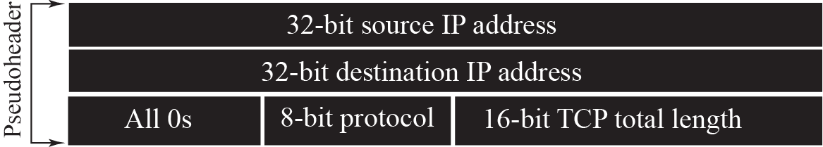
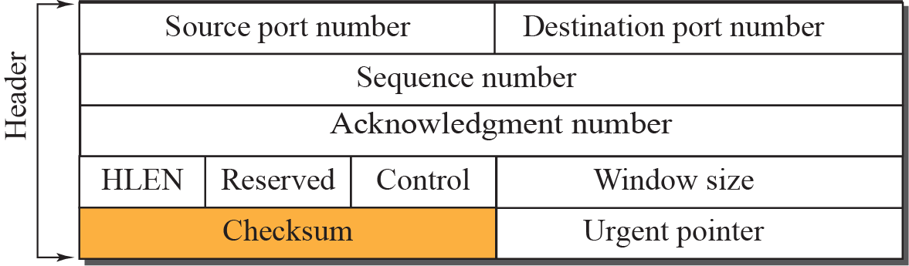

Figure 15.7 Pseudoheader added to the TCP segment

Slide 9

Note
The use of the checksum in TCP is mandatory.

Slide 10
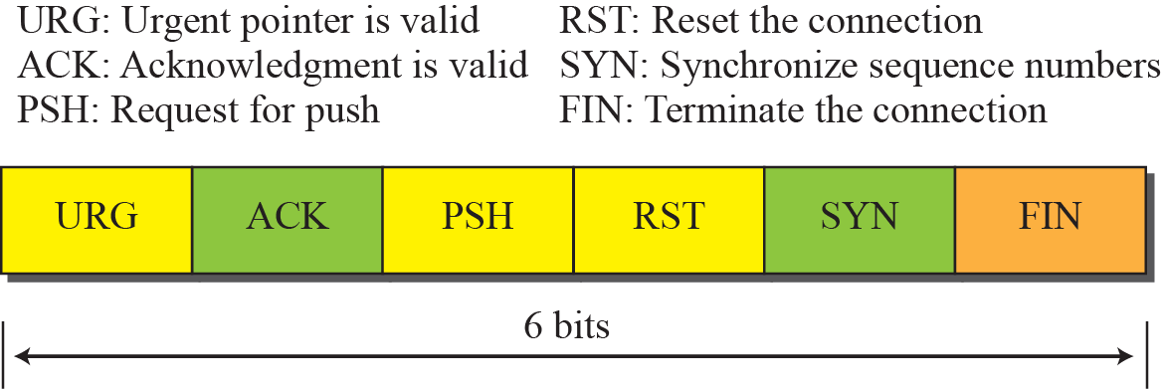
Figure 15.6 Control field

Slide 11
Figure 15.8 Encapsulation

Slide 12
End of TCP Segments

